Slide 1
Course Title - DevOps
Topic Title - DevOps Tools and Technologies
Code Repositories
Presenter’s Name - M ArunKumar
Presenter’s ID - IARE11151
Department Name - CSE (AI & ML)
Lecture Number - #
Presentation Date -

Slide 2
Course Overview
DevOps, a combination of "development" and "operations," is a software development methodology that emphasizes collaboration and communication between software developers and IT operations professionals.
The goal of DevOps is to streamline the software delivery process, from code development to deployment and maintenance, by breaking down silos between development and operations teams.

Slide 3
DevOps Tools and Technologies
DevOps is a set of practices, philosophies, and tools that aim to improve collaboration between development (Dev) and operations (Ops) teams, enabling faster and more reliable software delivery. Below is a list of commonly used DevOps tools and technologies
1. Version Control Systems (VCS)
Git: Distributed version control system for tracking code changes.
Platforms: GitHub, GitLab, Bitbucket
Subversion (SVN): Centralized version control system.
2. Continuous Integration and Continuous Delivery (CI/CD)
Jenkins: Open-source automation server for CI/CD pipelines.
GitLab CI/CD: Integrated CI/CD tools within GitLab.tool.
GitHub Actions: CI/CD and automation directly within GitHub.CD: Declarative GitOps tool for Kubernetes.
Notes:
a system, process, department, etc. that operates in isolation from others.

Slide 4
DevOps Tools and Technologies
3. Configuration Management
Ansible: Agentless automation tool for configuration management and deployment.
Puppet: Configuration management tool for automating infrastructure.
Chef: Infrastructure automation framework.
SaltStack: Configuration management and remote execution tool.
4. Infrastructure as Code (IaC)
Terraform: Open-source tool for building, changing, and versioning infrastructure.
AWS CloudFormation: AWS-specific IaC tool.
Pulumi: General-purpose IaC tool using programming languages like Python, JavaScript, and Go.
Crossplane: Open-source IaC for Kubernetes.
Notes:
a system, process, department, etc. that operates in isolation from others.

Slide 5
DevOps Tools and Technologies
5. Containerization
Docker: Platform for developing, shipping, and running applications in containers.
Podman: Docker alternative with a daemonless architecture.
Containerd: Industry-standard container runtime.
6. Container Orchestration
Kubernetes (K8s): Open-source platform for automating containerized application deployment, scaling, and management.
Docker : Docker-native container orchestration tool.
Amazon ECS: AWS container orchestration service.
Nomad: Simple and flexible workload orchestrator by HashiCorp.
Notes:
a system, process, department, etc. that operates in isolation from others.

Slide 6
DevOps Tools and Technologies
7. Monitoring and Logging
Grafana: Open-source platform for monitoring and observability.
Elasticsearch: Search and analytics engine.
Logstash: Data processing pipeline.
Kibana: Data visualization tool.
Splunk: Platform for searching, monitoring, and analyzing machine-generated data.
New Relic: Application performance monitoring (APM) tool.
8. Collaboration and Communication
Slack: Team communication and collaboration tool.
Microsoft Teams: Collaboration platform integrated with Office 365.
Jira: Project management and issue tracking tool.
Confluence: Documentation and knowledge management tool.
Notes:
a system, process, department, etc. that operates in isolation from others.

Slide 7
DevOps Tools and Technologies
9. Cloud Platforms
Amazon Web Services (AWS): Comprehensive cloud services platform.
Microsoft Azure: Cloud computing services by Microsoft.
Google Cloud Platform (GCP): Cloud services by Google.
IBM Cloud: Cloud platform by IBM.
Oracle Cloud: Cloud services by Oracle.
10. Security and Compliance
HashiCorp Vault: Tool for managing secrets and protecting sensitive data.
Aqua Security: Container security platform.
SonarQube: Code quality and security analysis tool.
OWASP ZAP: Open-source web application security scanner.
Snyk: Developer-first security tool for vulnerabilities in dependencies.
Notes:
a system, process, department, etc. that operates in isolation from others.

Slide 8
DevOps Tools and Technologies
11. Testing Tools
Selenium: Open-source tool for browser automation.
JUnit: Testing framework for Java.
TestNG: Testing framework inspired by JUnit.
Cucumber: Tool for behavior-driven development (BDD).
Postman: API testing and development tool.
12. Database Management
Liquibase: Database schema change management tool.
Flyway: Database migration tool.
pgAdmin: Open-source PostgreSQL management tool.
Notes:
a system, process, department, etc. that operates in isolation from others.

Slide 9
DevOps Tools and Technologies
13. Scripting and Automation
Python: General-purpose scripting language for automation.
Bash: Unix shell scripting for automation.
PowerShell: Task automation and configuration management framework.
14. Serverless Platforms
AWS Lambda: Serverless compute service by AWS.
Azure Functions: Serverless compute service by Azure.
Google Cloud Functions: Serverless compute service by GCP.
15. Virtualization
VMware: Virtualization and cloud computing software.
VirtualBox: Open-source virtualization tool.
KVM: Kernel-based virtualization for Linux.
Notes:
a system, process, department, etc. that operates in isolation from others.

Slide 10
DevOps Tools and Technologies
16. AI/ML in DevOps
MLflow: Open-source platform for managing machine learning workflows.
Kubeflow: Kubernetes-native platform for machine learning.
These tools and technologies form the backbone of modern DevOps practices, enabling teams to automate, monitor, and optimize the software development lifecycle.
Notes:
a system, process, department, etc. that operates in isolation from others.

Slide 11
Code Repositories : Git, Differences between SVN and Git
Code repositories are essential for version control, collaboration, and managing codebases. The most widely used tools are Git and SVN (Subversion).
1. Git
Description: A distributed version control system (DVCS) that allows developers to track changes, collaborate, and manage code efficiently.
Key Features:
Distributed: Every developer has a full copy of the repository.
Branching and Merging: Lightweight branches and easy merging.
Speed: Optimized for performance.
Platforms: GitHub, GitLab, Bitbucket, Azure Repos.
Use Cases: Open-source projects, enterprise development, CI/CD pipelines.
Notes:
a system, process, department, etc. that operates in isolation from others.

Slide 12
Code Repositories : Git, Differences between SVN and Git
2. SVN (Subversion)
Description: A centralized version control system (CVCS) where the repository is stored on a central server.
Key Features:
Centralized: Developers check out files from a central repository.
Atomic Commits: Ensures that a commit either fully succeeds or fails.
Directory Versioning: Tracks changes to directories and files.
Use Cases: Legacy projects, organizations preferring centralized control.
Notes:
a system, process, department, etc. that operates in isolation from others.

Slide 13
Code Repositories : Git, Differences between SVN and Git
Differences Between Git and SVN
Feature | Git | SVN
Architecture | Distributed (every user has a full copy). | Centralized (single central repository).
Branching | Lightweight and fast. | Slower and more complex.
Merging | Easier and more efficient. | More challenging and error-prone.
Speed | Faster for most operations. | Slower due to centralized nature.
Offline Work | Fully functional offline. | Limited offline capabilities.
Learning Curve | Steeper due to distributed nature. | Easier for beginners.
Storage | Stores snapshots of the entire project. | Stores differences between files.
Popular Platforms | GitHub, GitLab, Bitbucket. | Apache Subversion, VisualSVN.
Notes:
a system, process, department, etc. that operates in isolation from others.

Slide 14
Code Repositories : Git, create a new repository on the command line
create a new repository
echo "# seleniumpy" >> README.md
git init
git add README.md
git commit -m "first commit"
git branch -M main
git remote add origin https://github.com/makmakindia/seleniumpy.git
git push -u origin main
push an existing repository from the command line
git remote add origin https://github.com/makmakindia/seleniumpy.git
git branch -M main
git push -u origin main
Notes:
a system, process, department, etc. that operates in isolation from others.

Slide 15
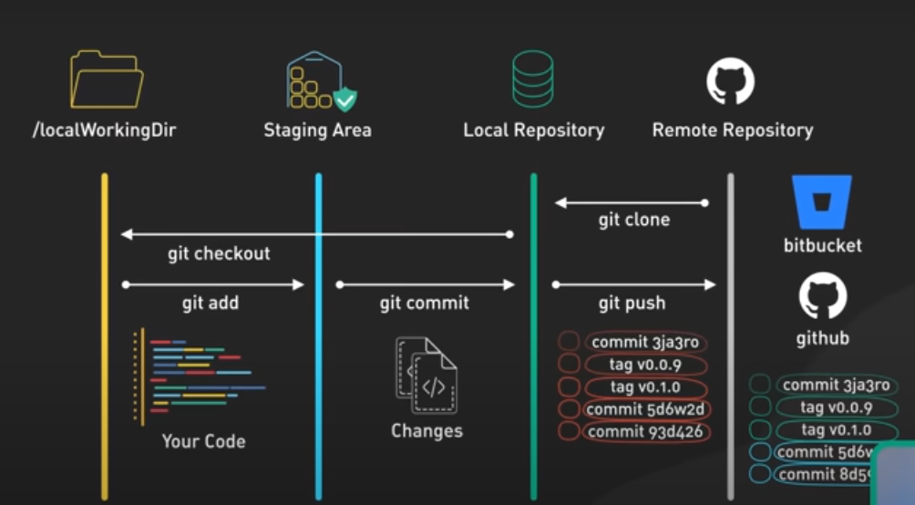

Slide 16
Build tools – Maven
Maven is a build automation tool primarily used for projects, It simplifies the build process by managing dependencies, compiling source code, running tests, packaging the application, and deploying the final product.
Key Features of Maven:
Dependency Management: Maven allows you to manage your project's dependencies and Maven will automatically download and manage these libraries.
Project Object Model (POM): The pom.xml file is the core of a Maven project. such as dependencies, build settings, plugins, and more.
Build Lifecycle: Maven uses a set of predefined phases for building and deploying applications.
clean: Cleans the project, removing any previously compiled or generated files.
validate: Validates the project structure.
compile: Compiles the source code of the project.
test: Runs the unit tests.
package: Packages the compiled code into a distributable format (e.g., JAR, WAR).
install: Installs the packaged application to the local repository.
deploy: Deploys the application to a remote repository or server.
Notes:
a system, process, department, etc. that operates in isolation from others.

Slide 17
Build tools – Maven
4. Plugins: Maven is highly extensible through the use of plugins. There are various plugins available for tasks like compiling code, packaging artifacts, running tests, and more.
5. Repositories: Maven uses repositories to store and retrieve dependencies. These repositories can be local (on your machine), central (Maven Central Repository), or remote (private repositories).

Slide 18
my-app/
│
├── pom.xml # Project descriptor file
├── src/
│ ├── main/
│ │ ├── java/ # Java source code
│ │ └── resources/ # Project resources (like property files, images)
│ │
│ └── test/
│ ├── java/ # Test source code
│ └── resources/ # Test resources
├── target/ # Compiled code, JAR/WAR files
└── .gitignore # Git ignore file (if using Git)

Slide 19
Example of a pom.xml File
Common Maven Commands:
Compile the project: mvn compile
Run tests : mvn test
Package the project (e.g., JAR/WAR): mvn install
Clean the project (delete compiled files): mvn clean
Build and deploy the project: mvn deploy

Slide 20
Build tools – Maven
Common Maven Commands:
Compile the project: mvn compile
Run tests : mvn test
Package the project (e.g., JAR/WAR): mvn install
Clean the project (delete compiled files): mvn clean
Build and deploy the project: mvn deploy
Benefits of Using Maven:
Consistent Builds: Ensures that builds are consistent across different environments (local, continuous integration, etc.).
Centralized Dependency Management: Automatically handles downloading and managing dependencies.
Plugin-based Architecture: The build process is highly customizable through plugins.
Project Structure Convention: Encourages a standard project structure that simplifies collaboration.
Cross-platform: Works on any platform that supports Java, ensuring portability.

Slide 21
Thank You

